Slide 1
DATA STRUCTURES AND ALGORITHMS
SLIDE 5

Slide 2
HEAP
A binary heap is a binary tree with two other constraints
1) Shape(Structural) Property: A binary heap is a complete binary tree, this means all of the levels of the tree are completely filled except possibly the last level. The nodes are filled from left to right.

Slide 3
2) Heap(order) Property: The ordering can be one of two types:
i) min-heap property: the value of each node is greater than or equal to the value of its parent, with the minimum-value element at the root.
ii) max-heap property: the value of each node is less than or equal to the value of its parent, with the maximum-value element at the root

Slide 4
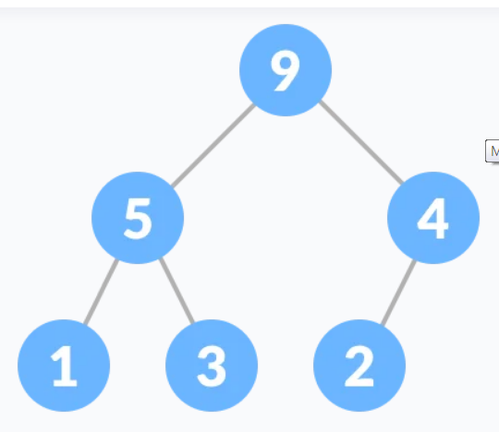
Heap Property is the property of a node in which
(for max heap) key of each node is always greater than its child node/s and the key of the root node is the largest among all other nodes;

Slide 5
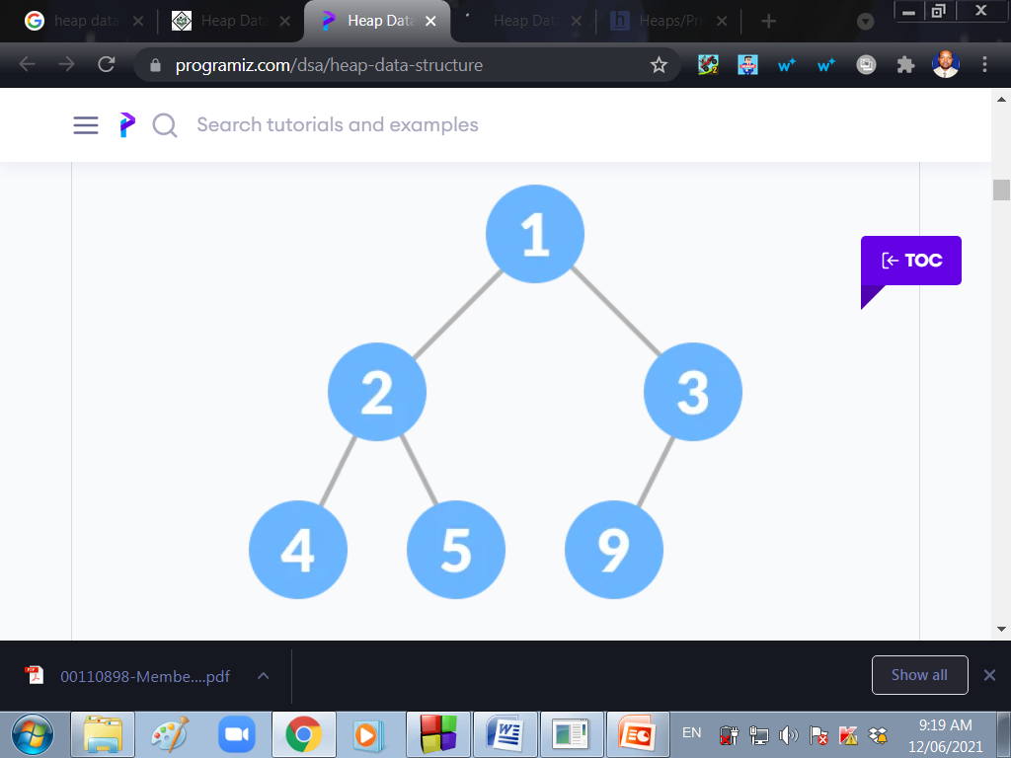
(for min heap) key of each node is always smaller than the child node/s and the key of the root node is the smallest among all other nodes.

Slide 6
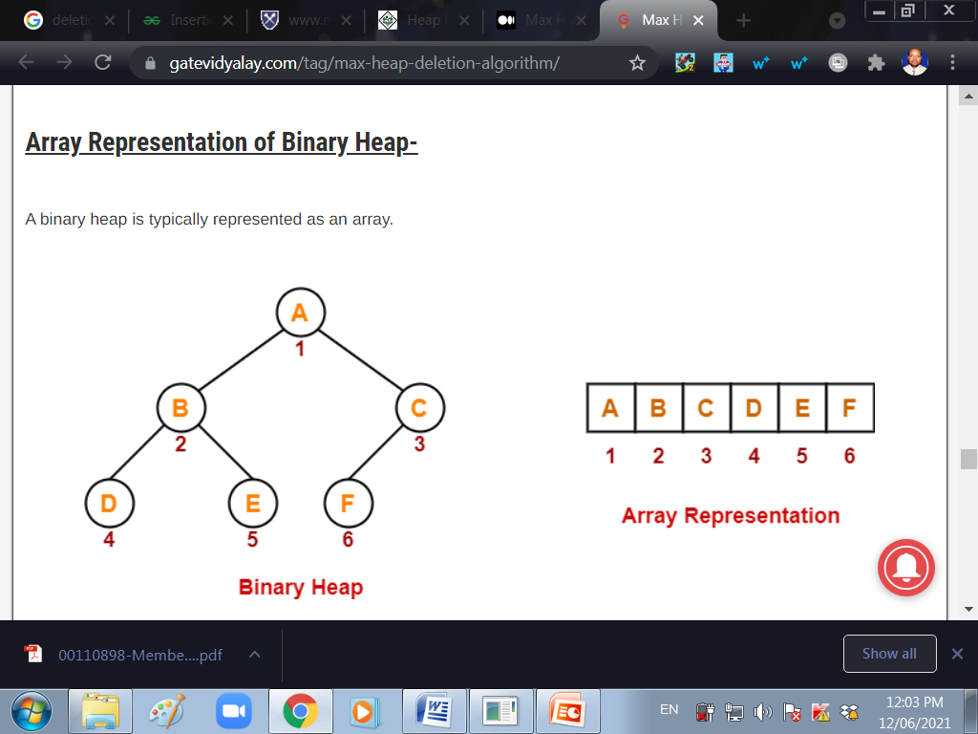

Slide 7
Upheap:
The upheap process is used to add a node to a heap. When you upheap a node, you compare its value to its parent node; if its value is less than its parent node, then you switch the two nodes and continue the process. Otherwise the condition is met that the parent node is less than the child node, and so you can stop the process. Once you find a parent node that is less than the node being upheaped, you know that the heap is correct--the node being upheaped is greater than its parent, and its parent is greater than its own parent, all the way up to the root.

Slide 8
Downheap:
The downheap process is similar to the upheaping process. When you downheap a node, you compare its value with its two children. If the node is less than both of its children, it remains in place; otherwise, if it is greater than one or both of its children, then you switch it with the child of lowest value, thereby ensuring that of the three nodes being compared, the new parent node is lowest. Of course, you cannot be assured that the node being downheaped is in its proper position -- it may be greater than one or both of its new children; the downheap process must be repeated until the node is less than both of its children.

Slide 9
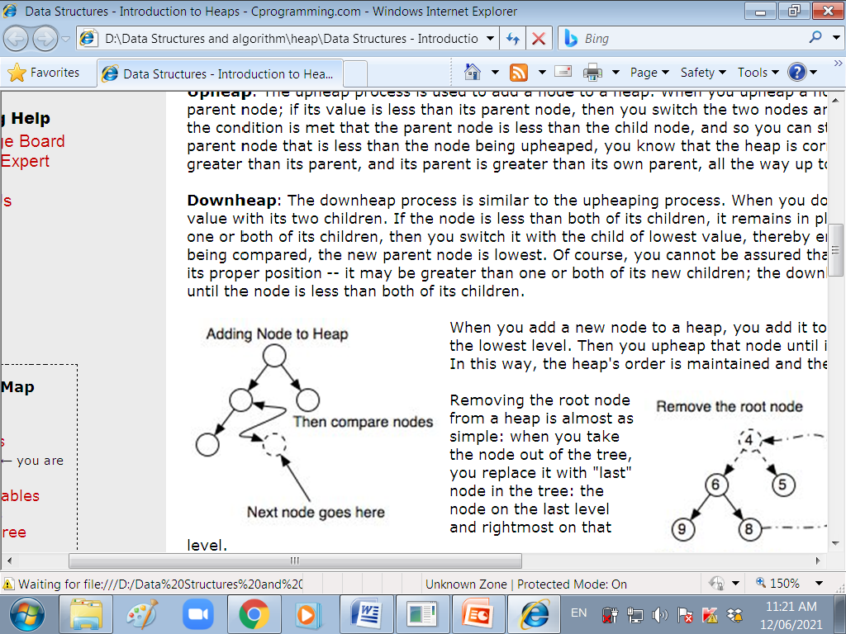
INSERTING A NODE
When you add a new node to a heap, you add it to the rightmost unoccupied leaf on the lowest level. Then you upheap that node until it has reached its proper position. In this way, the heap's order is maintained and the heap remains a complete tree.

Slide 10
DELETING A NODE
when you take the node out of the tree, you replace it with "last" node in the tree(the node on the last level and rightmost). Once the top node has been replaced, you downheap the node that was moved until it reaches its proper position.

Slide 11
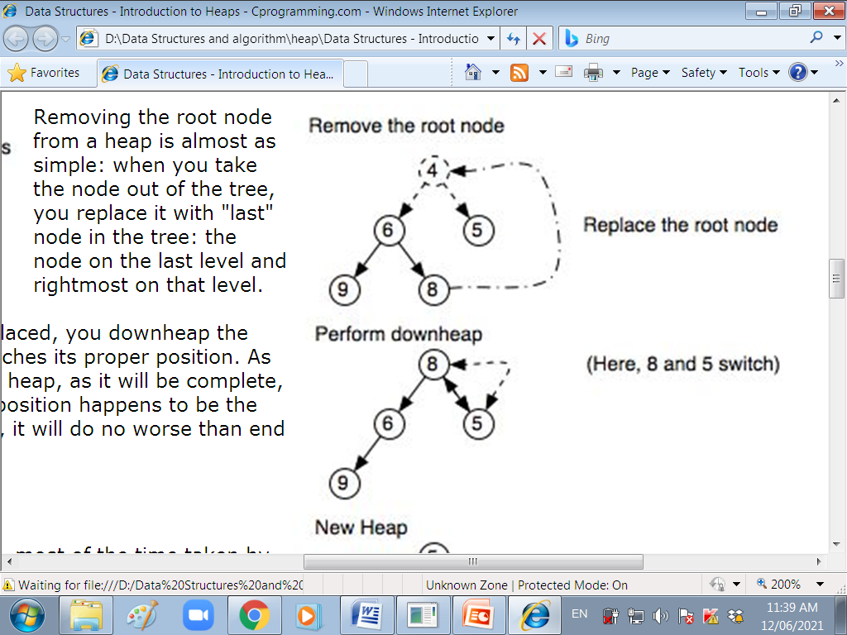
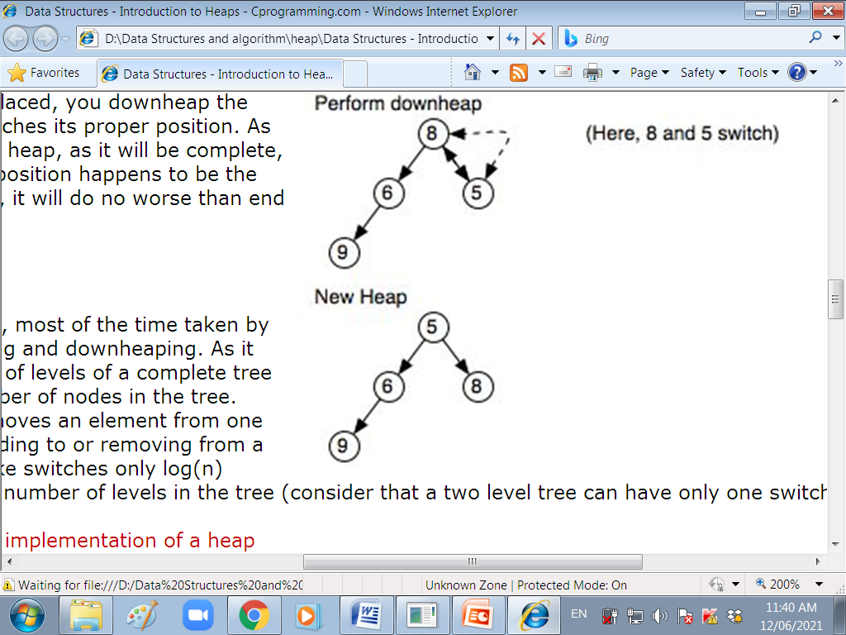

Slide 12
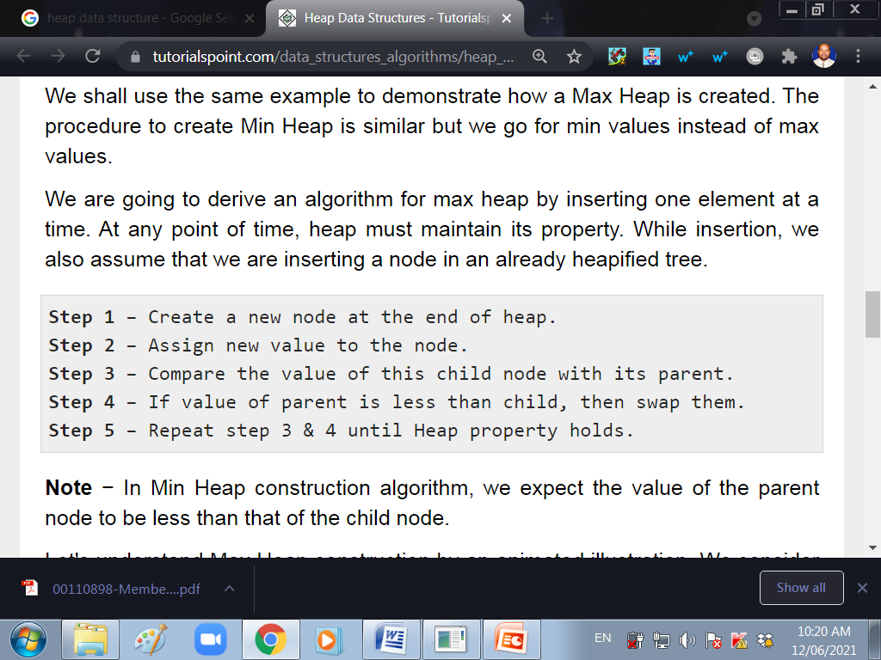
INSERTING AN ELEMENT INTO A MAX HEAP

Slide 13
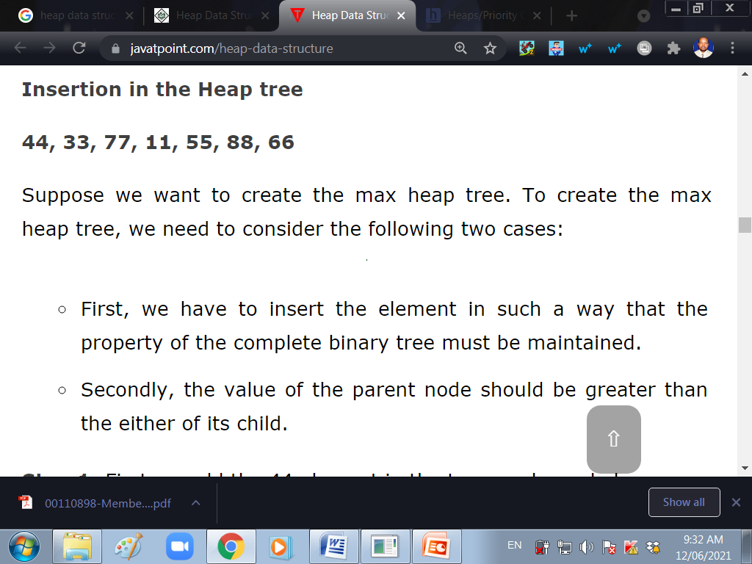

Slide 14
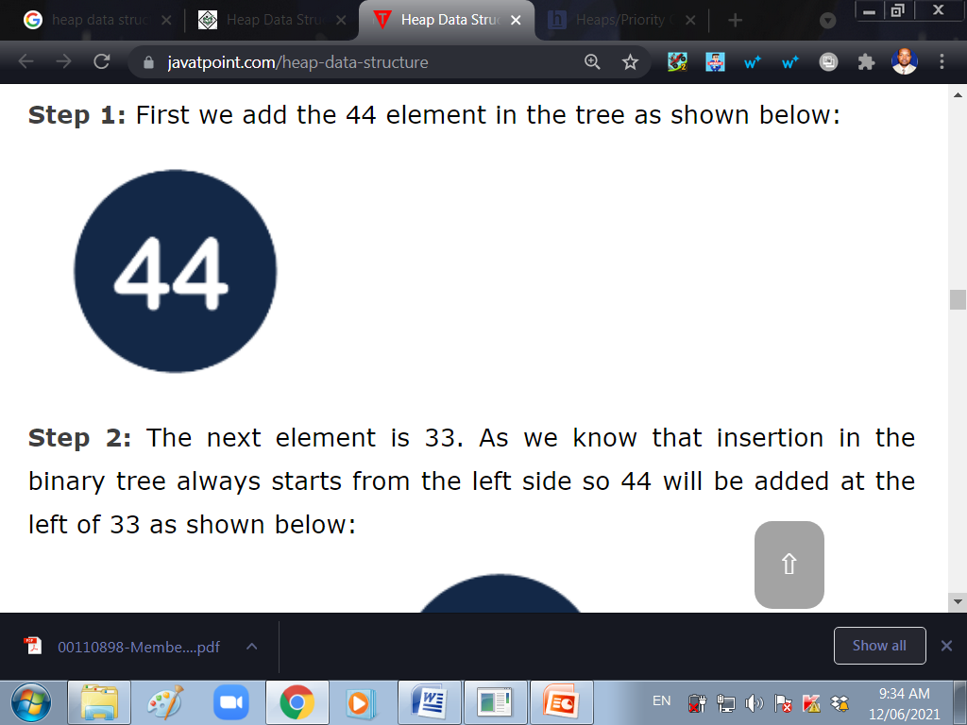
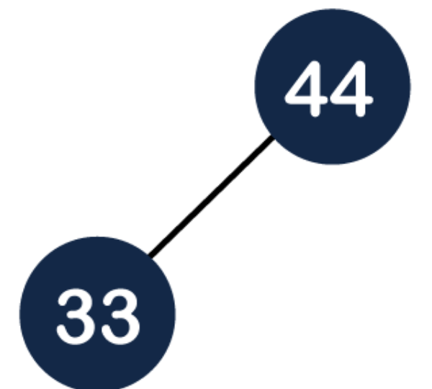

Slide 15
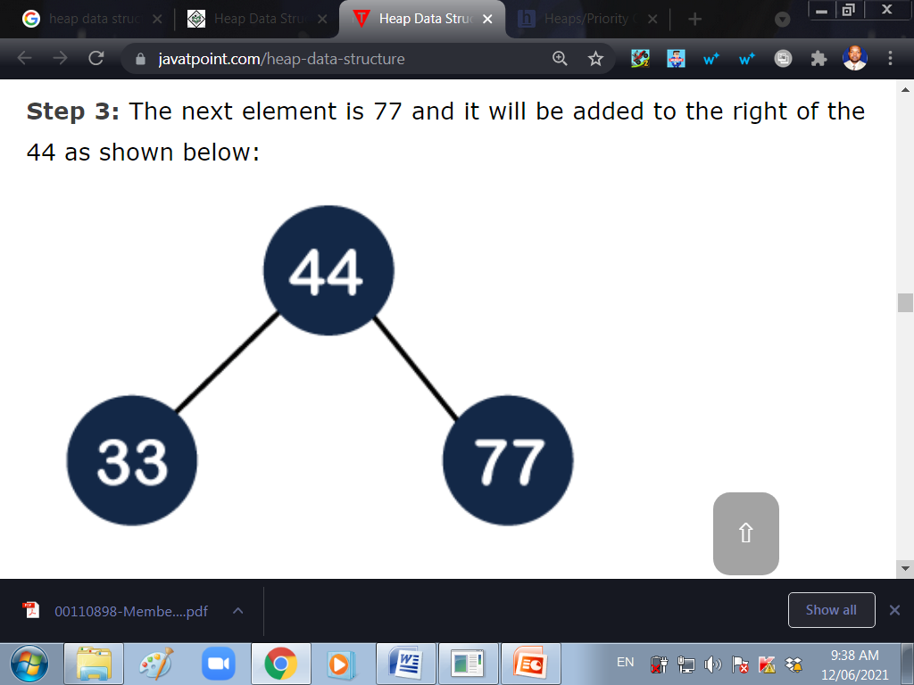

Slide 16
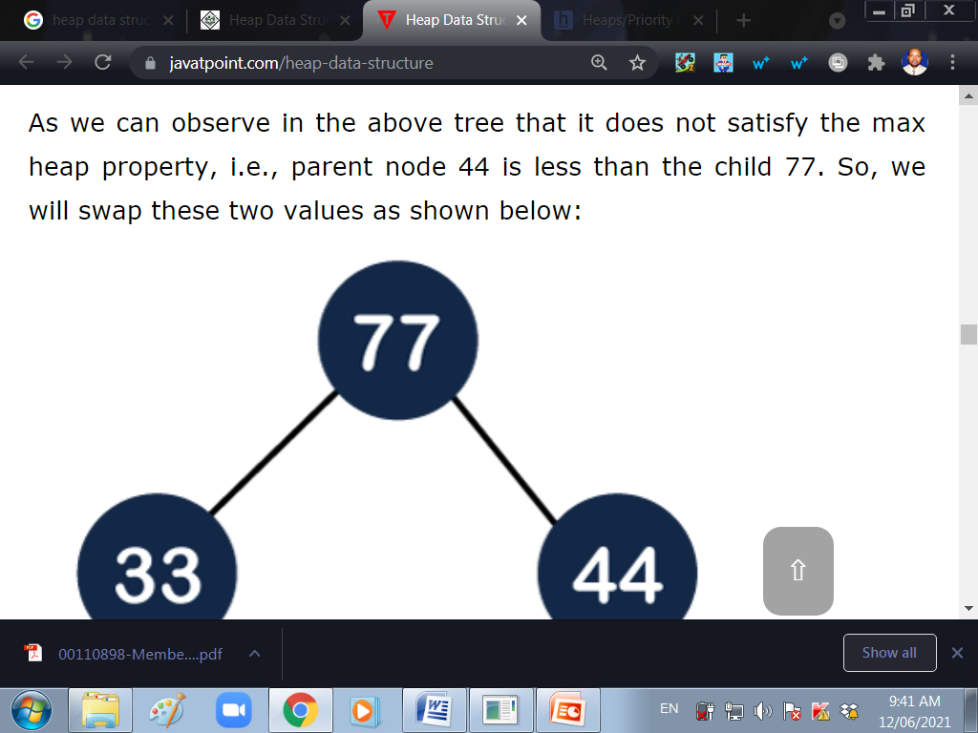

Slide 17
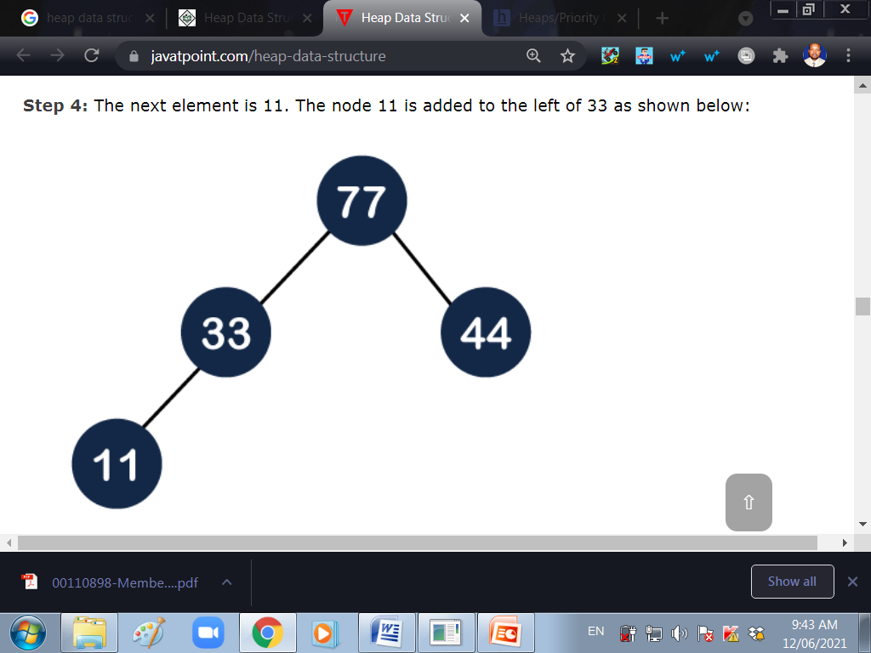

Slide 18
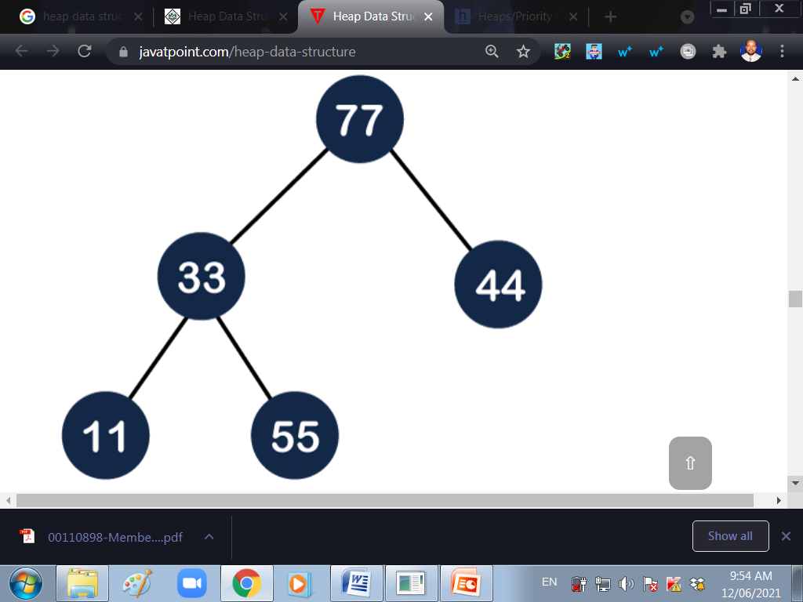
Step 5: The next element is 55. To make it a complete binary tree, we will add the node 55 to the right of 33 as shown below:

Slide 19
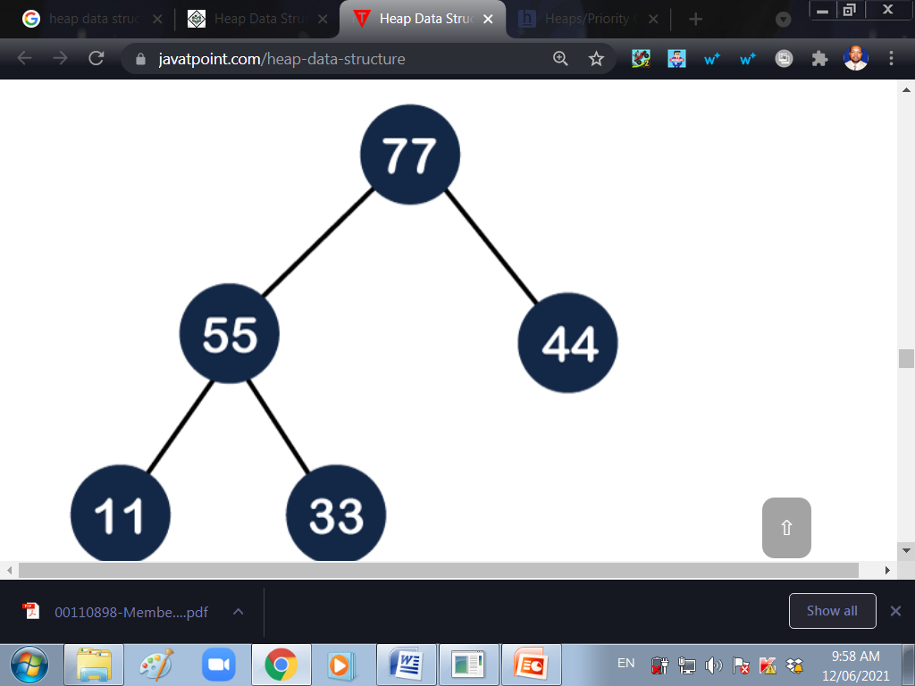
The above figure does not satisfy the property of the max heap because 33 < 55, so we will swap these two values as shown below:

Slide 20
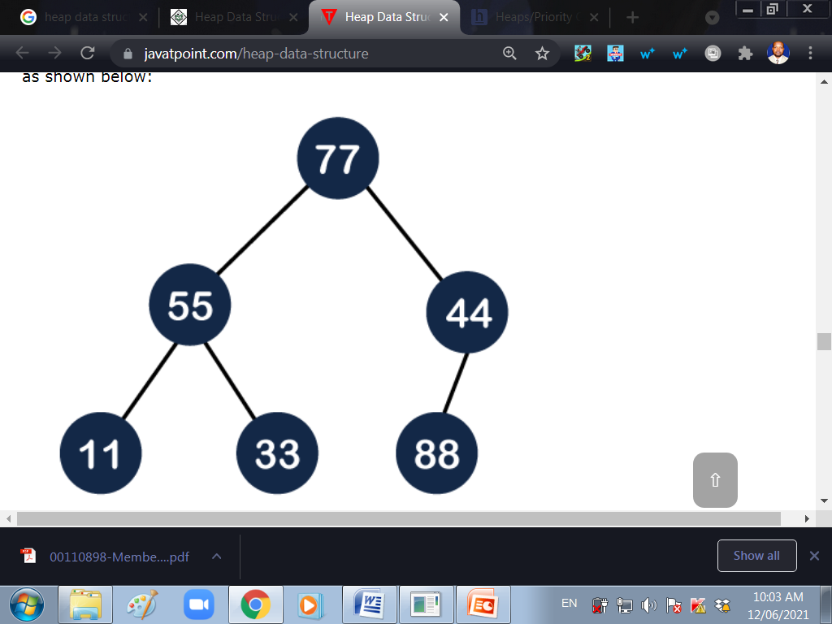
Step 6: The next element is 88. The left sub tree is completed so we will add 88 to the left of 44 as shown below:
Since 44<88, swap these two values as shown below:
Again, it is violating the max heap property because 88>77 so we will swap these two values below:

Slide 21
Step 7: The next element is 66. To make a complete binary tree, we will add the 66 element to the right side of 77 as shown below

Slide 22
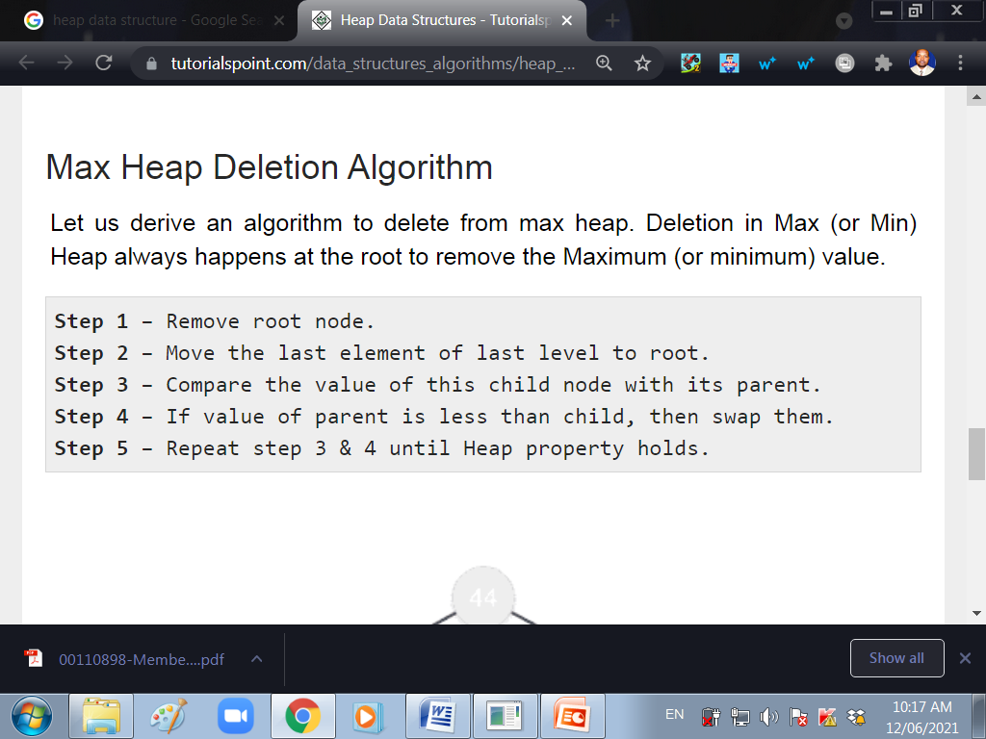

Slide 23
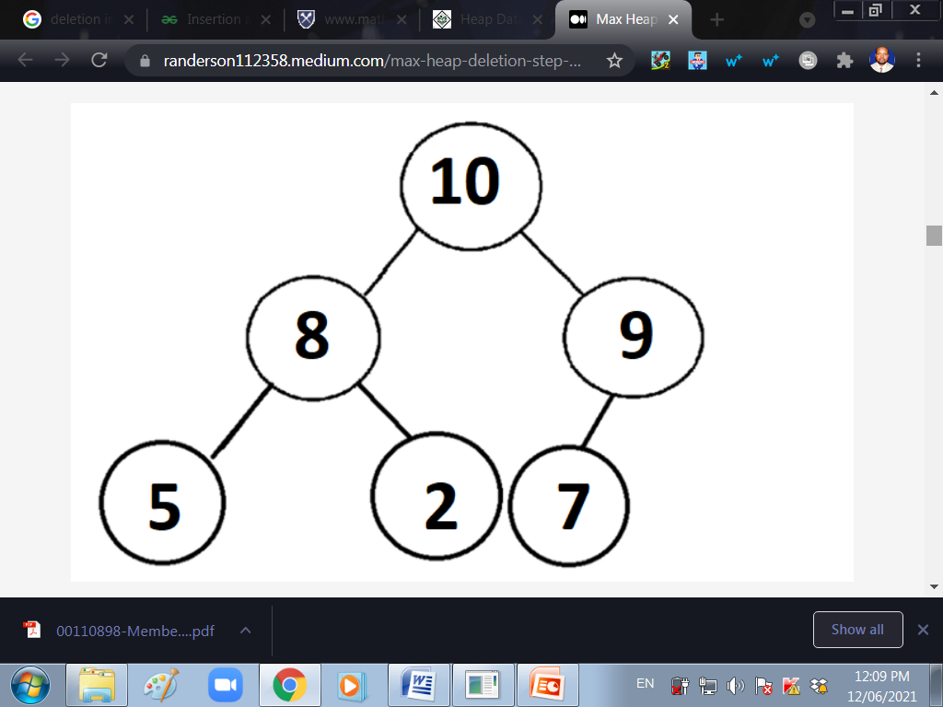
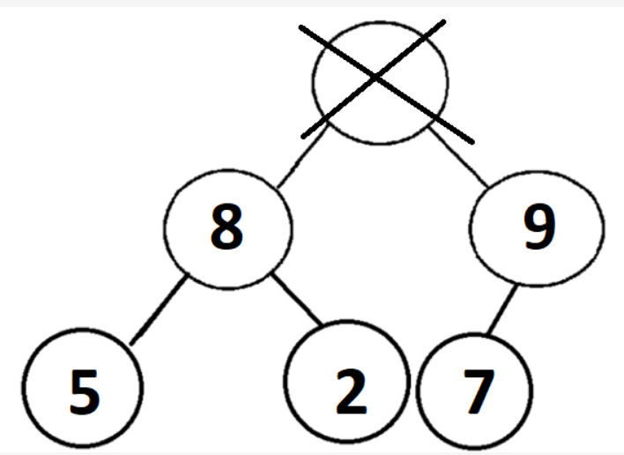
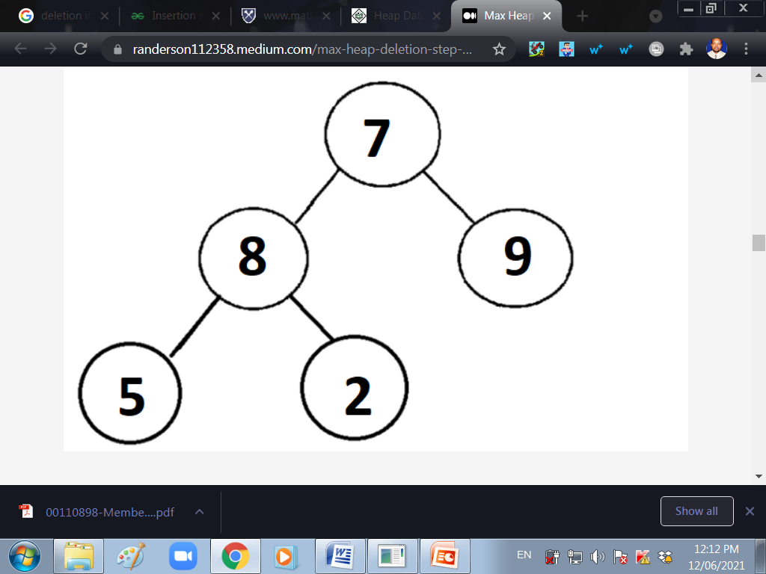
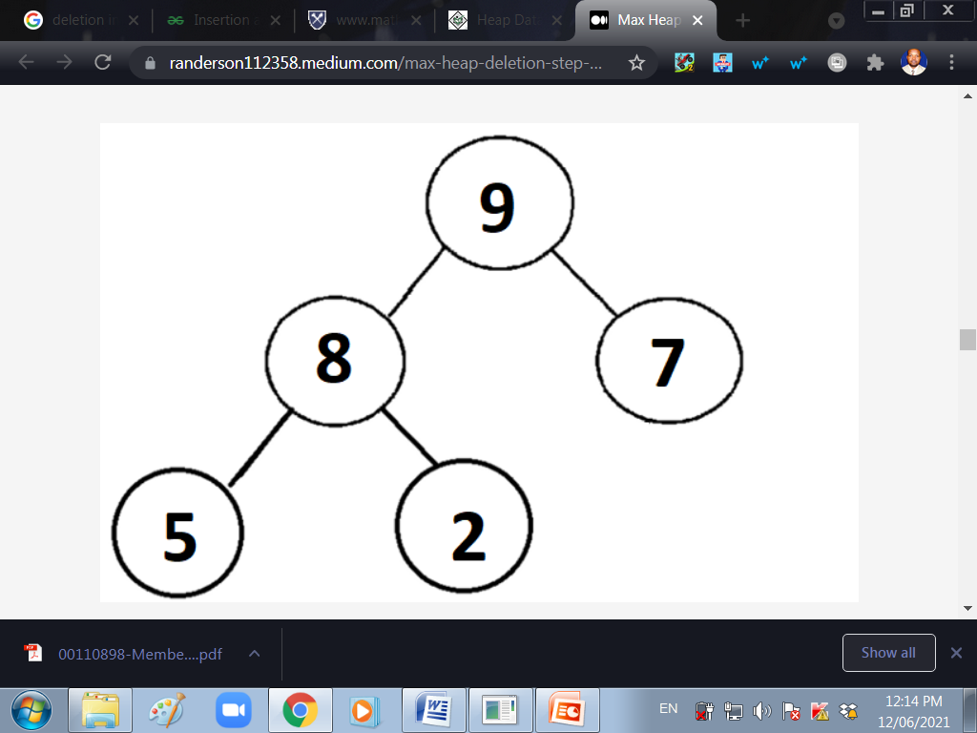
1. Deletete Root
2. Replace Root with last element
3. Heapify
4.Repeat process with other elements

Slide 25
END.
WAIRAGU G.R.

